Slide 1
Battle of Neighbourhood - Week 1&2

Slide 2
Introduction
If you want to find the good hangout place and have more number of coffee shops . The problem we aim to solve is to analyze the coffee shops locations in the major US cities and find the best hangout place.

Slide 3
Data section
FourSquare API will be used to collect data about locations of Coffee shops in Central Toronto and North York

Slide 4
Methodology
My main target here is to asses which city would have the highest coffee shops. I used the Four Square API
through the venues channel.
I used the near query to get venues in the cities. Also, I use the CategoryID to set it to show only Coffee shops.
An Example of my requests:
https://api.foursquare.com/v2/venues/explore?&client_id=&client_secret=&v=20180605&New York,
NY&limit=100&categoryId=’’
. Also, Foursquare limits us to maximum of 100 venues per query.
Moreover, I repeated this request for the 2 studied cities and got their top 100 venues.
I saved the name and coordinate data only from the result and plotted them on the map for visual inspection.
Next, to get an indicator of the density of Coffee shops, I calculated a center coordinate of the venues to
get the mean longitude and latitude values.
Then I calculated the mean of the Euclidean distance from each venue to the mean coordinates.
That was my indicator; mean distance to the mean coordinate.

Slide 5
Results
Thus it can be determined that North York has many Coffee Shops than Central Toronto. Thus can be good hangout place.

Slide 6
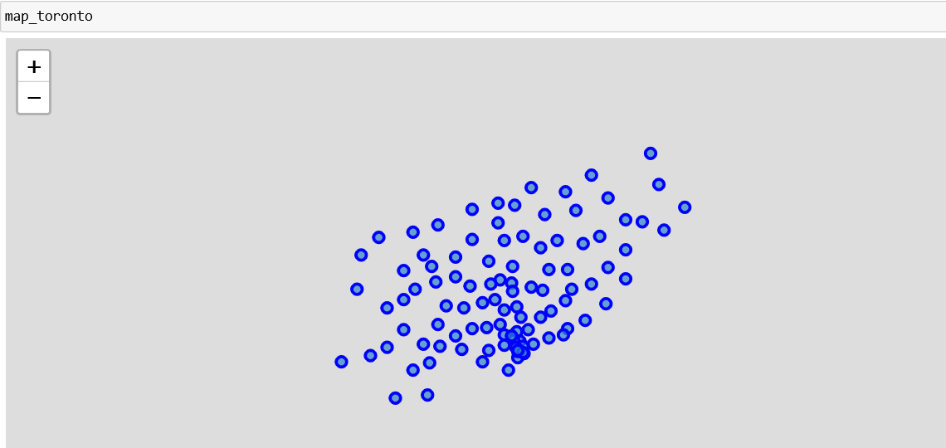

Slide 7
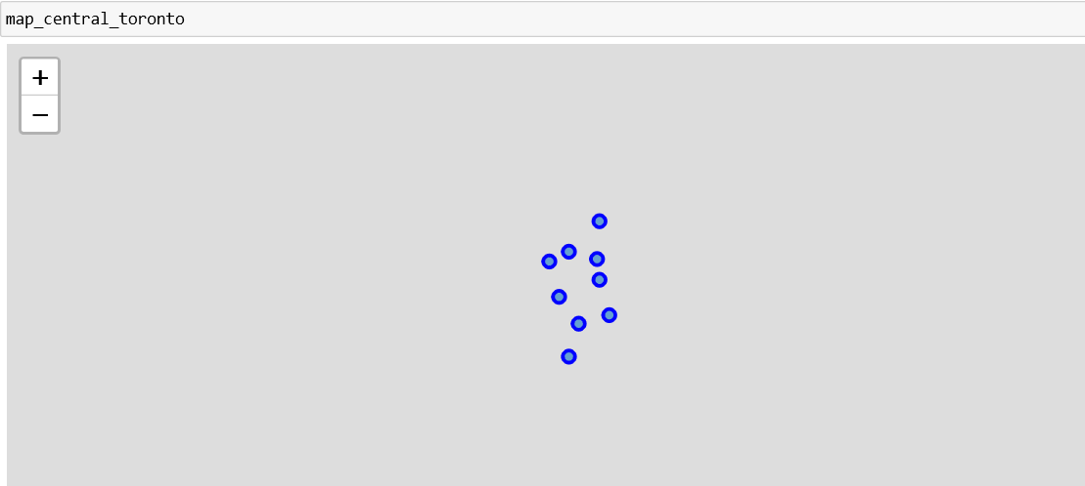

Slide 8
